Slide 1

FACULTY OF INFORMATION TECHNOLOGY
Fall,20172017
MAT 207- LINEAR ALGEBRA
Lecture 5 – Determinants
02/09/2018
Lecture 5: Determinants
1

Slide 2
Content
1
Introduction to Determinants
2
Properties of Determinants
3
Crammer’s Rule, Volume, and Linear Transformations
02/09/2018
Lecture 5: Determinants
2

Slide 3
Introduction to Determinants

Slide 4
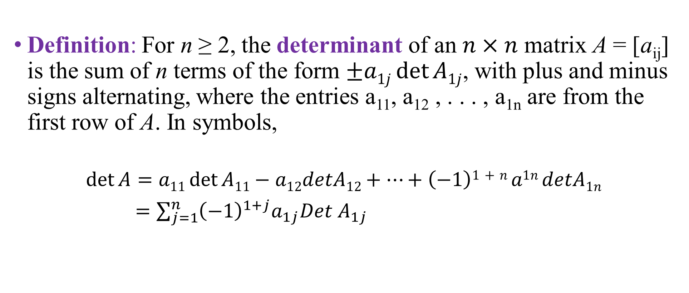
Introduction to Determinants
Definition: For n ≥ 2, the determinant of an $n×n$ matrix A = [a_{ij}] is the sum of n terms of the form $±a1j\det{A1j}$, with plus and minus signs alternating, where the entries a₁₁, a₁₂ , . . . , a_{1n} are from the first row of A. In symbols,
$$\det{A=a11\det{A11−a12detA12+…+\left(−1\right)1+n a1n detA1n}}$$
$=\sum_{j=1}^{n}{{\left(−1\right)}^{1+j}a_{1j}{Det A}_{1j}}$

Slide 5
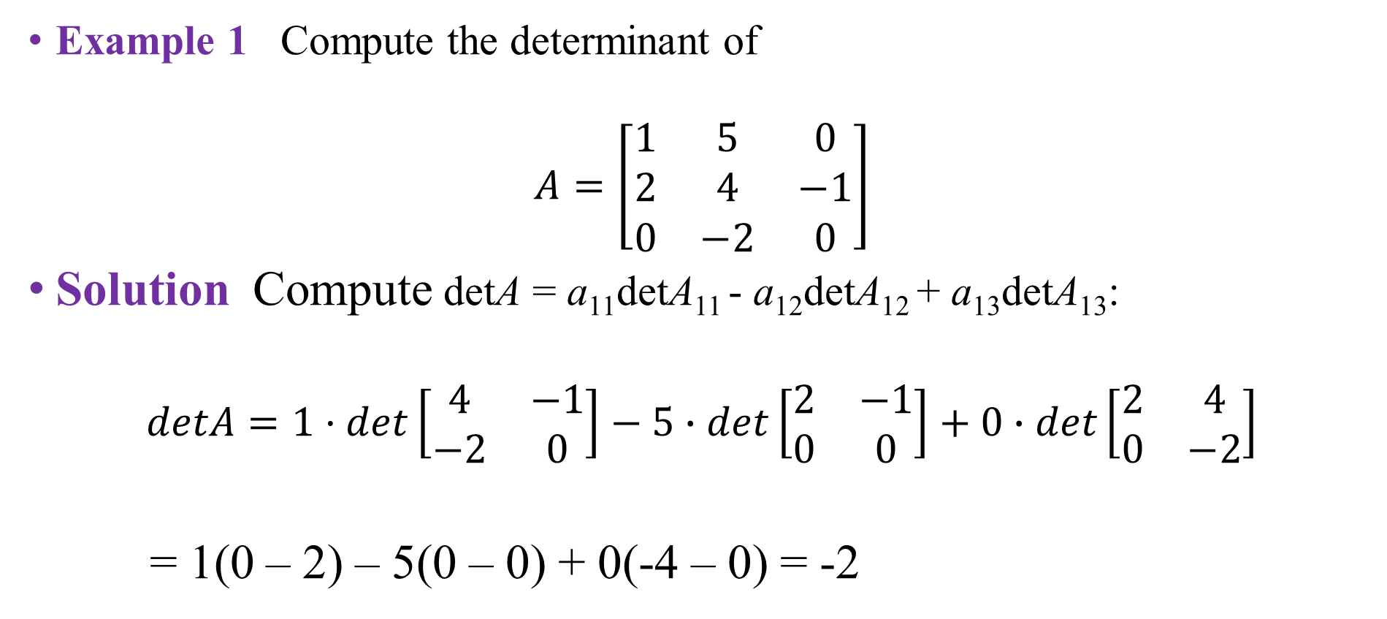
Introductions to Determinants
Example 1 Compute the determinant of
$$A=\left[\begin{matrix}1 & 5 & 0 \\ 2 & 4 & −1 \\ 0 & −2 & 0\end{matrix}\right]$$
Solution Compute detA = a₁₁detA₁₁ - a₁₂detA₁₂ + a₁₃detA₁₃:
$$detA=1·det\left[\begin{matrix}4 & −1 \\ −2 & 0\end{matrix}\right]−5∙det\left[\begin{matrix}2 & −1 \\ 0 & 0\end{matrix}\right]+0∙det\left[\begin{matrix}2 & 4 \\ 0 & −2\end{matrix}\right]$$
= 1(0 – 2) – 5(0 – 0) + 0(-4 – 0) = -2

Slide 6
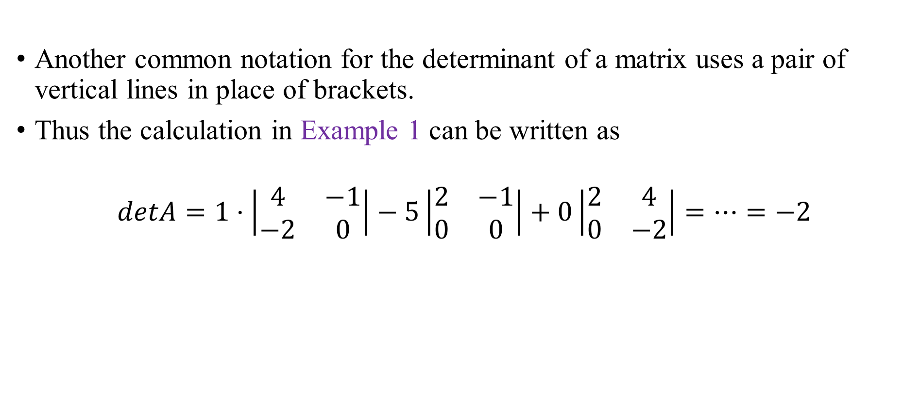
Introductions to Determinants
Another common notation for the determinant of a matrix uses a pair of vertical lines in place of brackets.
Thus the calculation in Example 1 can be written as
$$detA=1·\left|\begin{matrix}4 & −1 \\ −2 & 0\end{matrix}\right|−5\left|\begin{matrix}2 & −1 \\ 0 & 0\end{matrix}\right|+0\left|\begin{matrix}2 & 4 \\ 0 & −2\end{matrix}\right|=…=−2$$

Slide 7
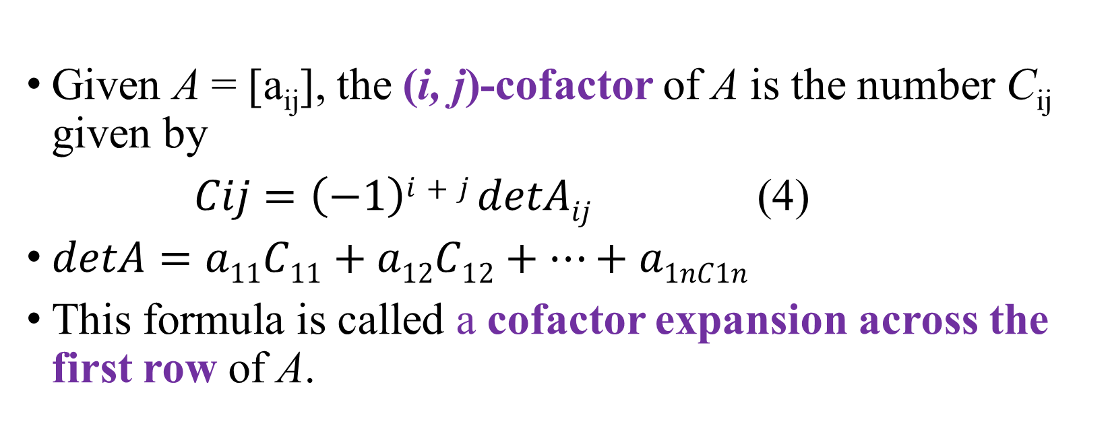
Introductions to Determinants
Given A = [a_{ij}], the (i, j)-cofactor of A is the number C_{ij} given by
$Cij=\left(−1\right)i+j detAij$ (4)
$detA=a11C11+a12C12+…+a1nC1n$
This formula is called a cofactor expansion across the first row of A.

Slide 8
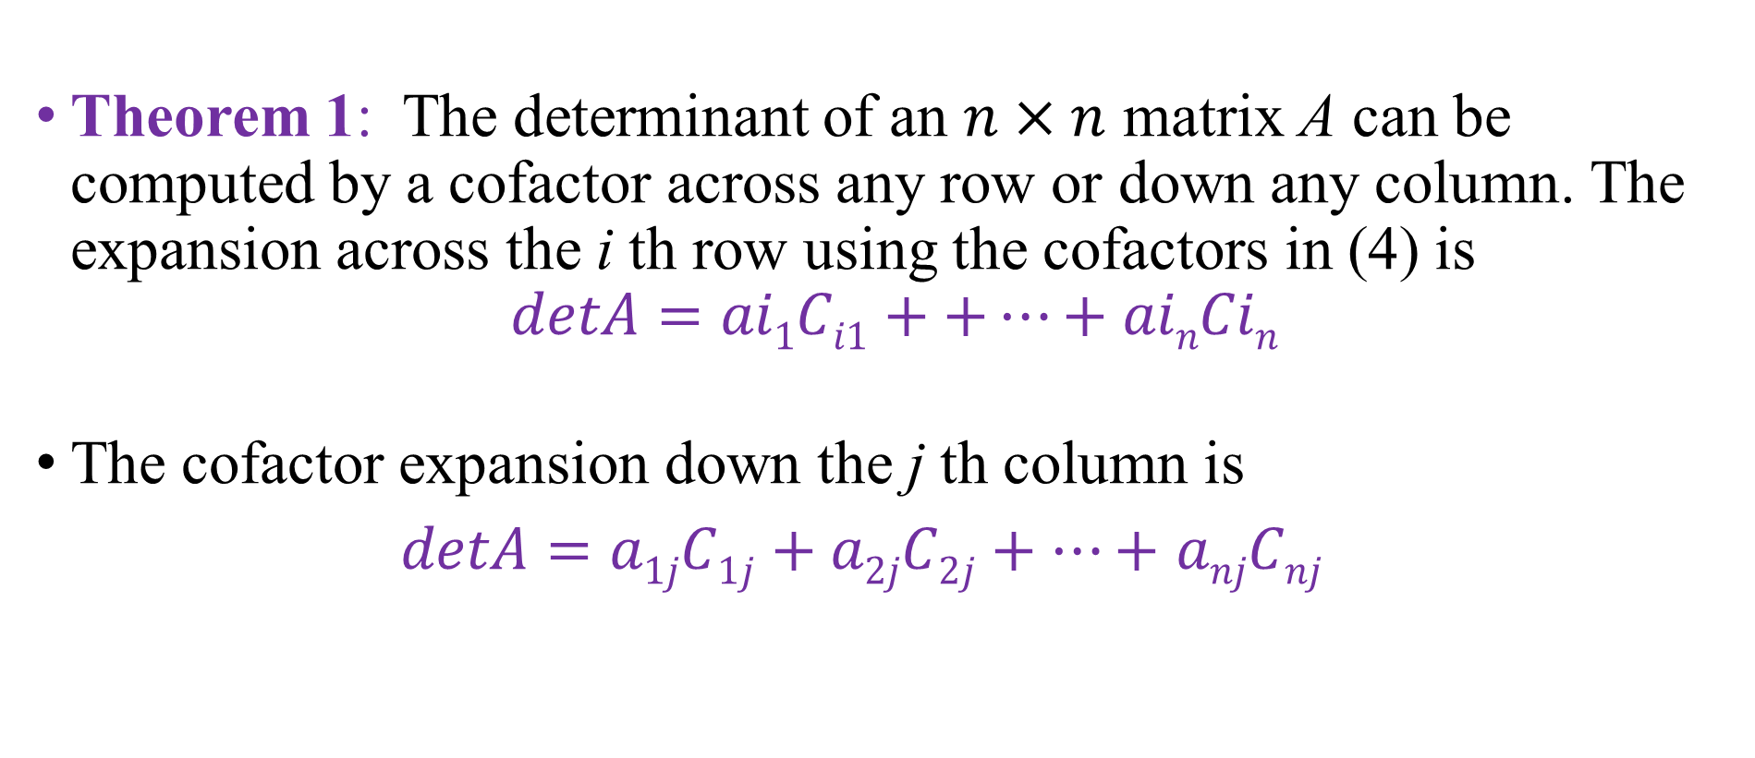
Introductions to Determinants
Theorem 1: The determinant of an $n×n$ matrix A can be computed by a cofactor across any row or down any column. The expansion across the i th row using the cofactors in (4) is
$$detA=ai1Ci1++…+ainCin$$
The cofactor expansion down the j th column is
$detA=a1jC1j+a2jC2j+…+$ $anjCnj$

Slide 9
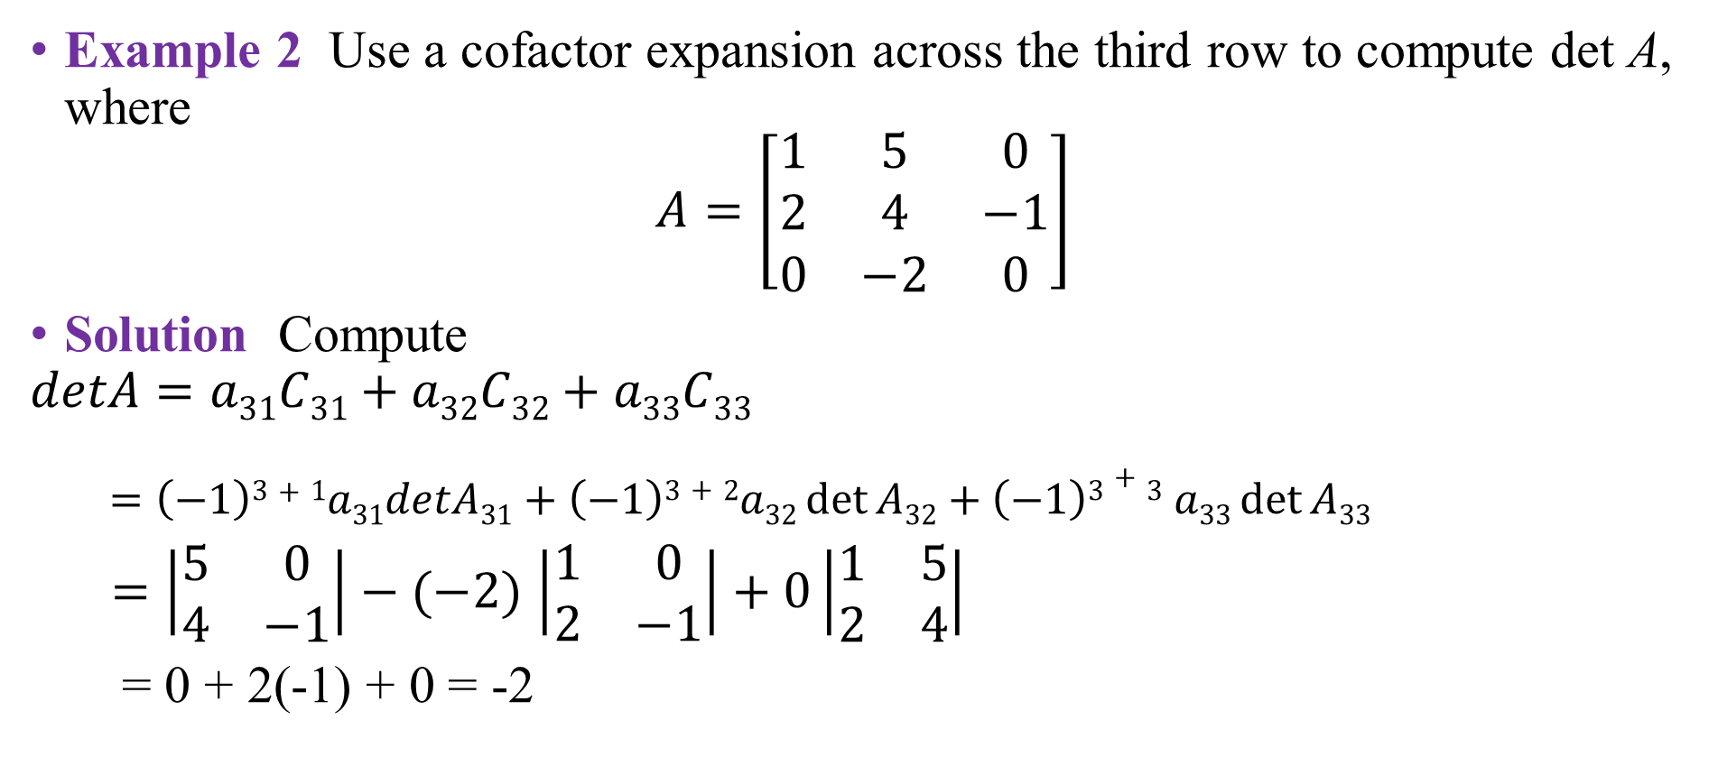
Introductions to Determinants
Example 2 Use a cofactor expansion across the third row to compute det A, where
$$A=\left[\begin{matrix}1 & 5 & 0 \\ 2 & 4 & −1 \\ 0 & −2 & 0\end{matrix}\right]$$
Solution Compute
$$detA=a31C31+a32C32+a33C33$$
$$=\left(−1\right)3+1a31detA31+\left(−1\right)3+2a32\det{A32+\left(−1\right)3+3 a33\det{A33}}$$
$=\left|\begin{matrix}5 & 0 \\ 4 & −1\end{matrix}\right|−(−2)$ $\left|\begin{matrix}1 & 0 \\ 2 & −1\end{matrix}\right|+0\left|\begin{matrix}1 & 5 \\ 2 & 4\end{matrix}\right|$
= 0 + 2(-1) + 0 = -2

Slide 10

Introductions to Determinants
Theorem 2: If A is a triangular matrix, then det A is the product of the entries on the main diagonal of A.
$$\left|\begin{matrix}a & ∗ & ∗ \\ 0 & b & ∗ \\ ∗ & 0 & c\end{matrix}\right|=abc$$

Slide 11
Properties of Determinants

Slide 12
Properties of Determinants
Theorem 3: Let A be a square matrix
If a multiple of one row of A is added to another row to produce a matrix B, then det B = det A.
If two rows of A are interchanged to produce B, then
det B = - det A.
If one row of A is multiplied by k to produce B, then
det B = k · det A

Slide 13
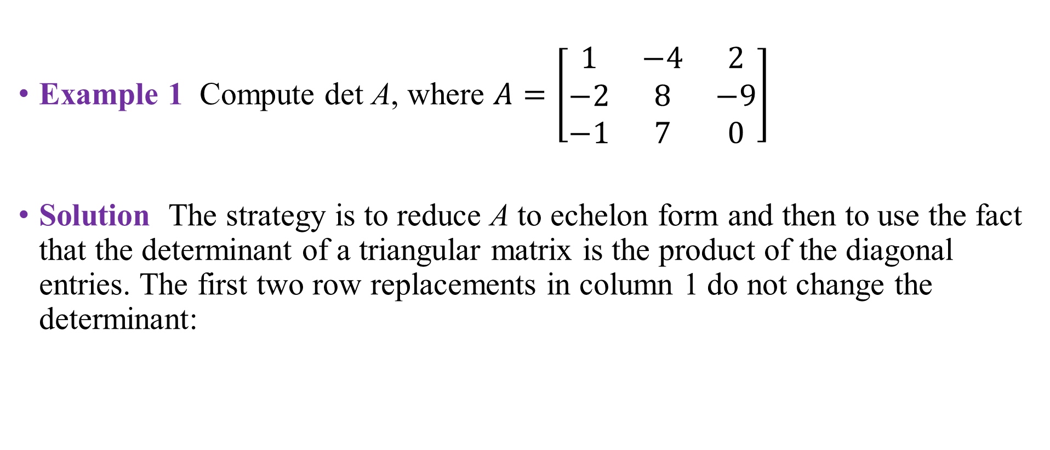
Properties of Determinants
Example 1 Compute det A, where $A=\left[\begin{matrix}1 & −4 & 2 \\ −2 & 8 & −9 \\ −1 & 7 & 0\end{matrix}\right]$
Solution The strategy is to reduce A to echelon form and then to use the fact that the determinant of a triangular matrix is the product of the diagonal entries. The first two row replacements in column 1 do not change the determinant:

Slide 14
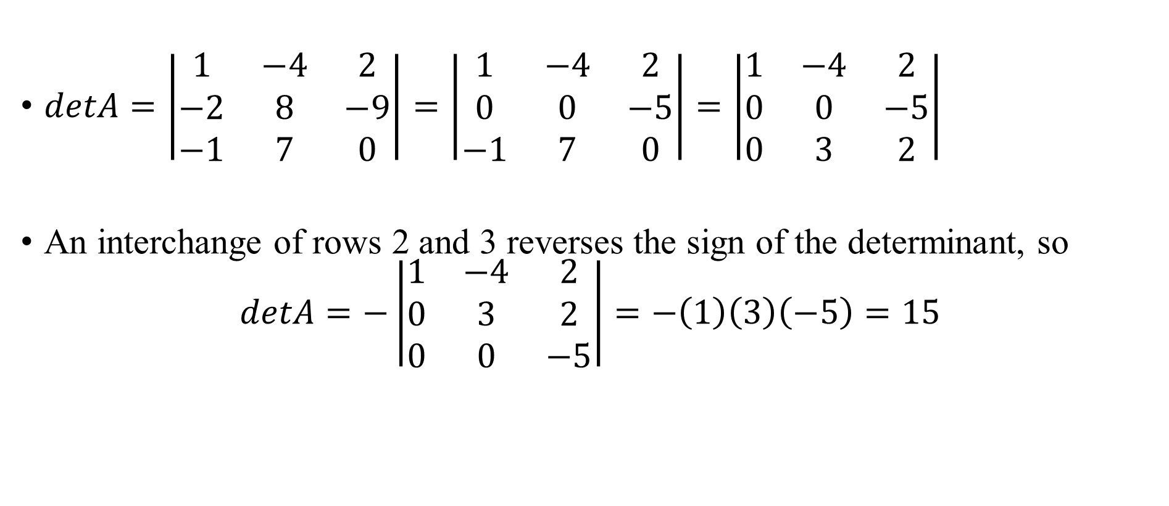
Properties of Determinants
$detA=\left|\begin{matrix}1 & −4 & 2 \\ −2 & 8 & −9 \\ −1 & 7 & 0\end{matrix}\right|=\left|\begin{matrix}1 & −4 & 2 \\ 0 & 0 & −5 \\ −1 & 7 & 0\end{matrix}\right|=\left|\begin{matrix}1 & −4 & 2 \\ 0 & 0 & −5 \\ 0 & 3 & 2\end{matrix}\right|$
An interchange of rows 2 and 3 reverses the sign of the determinant, so
$$detA=−\left|\begin{matrix}1 & −4 & 2 \\ 0 & 3 & 2 \\ 0 & 0 & −5\end{matrix}\right|=−\left(1\right)\left(3\right)\left(−5\right)=15$$

Slide 15
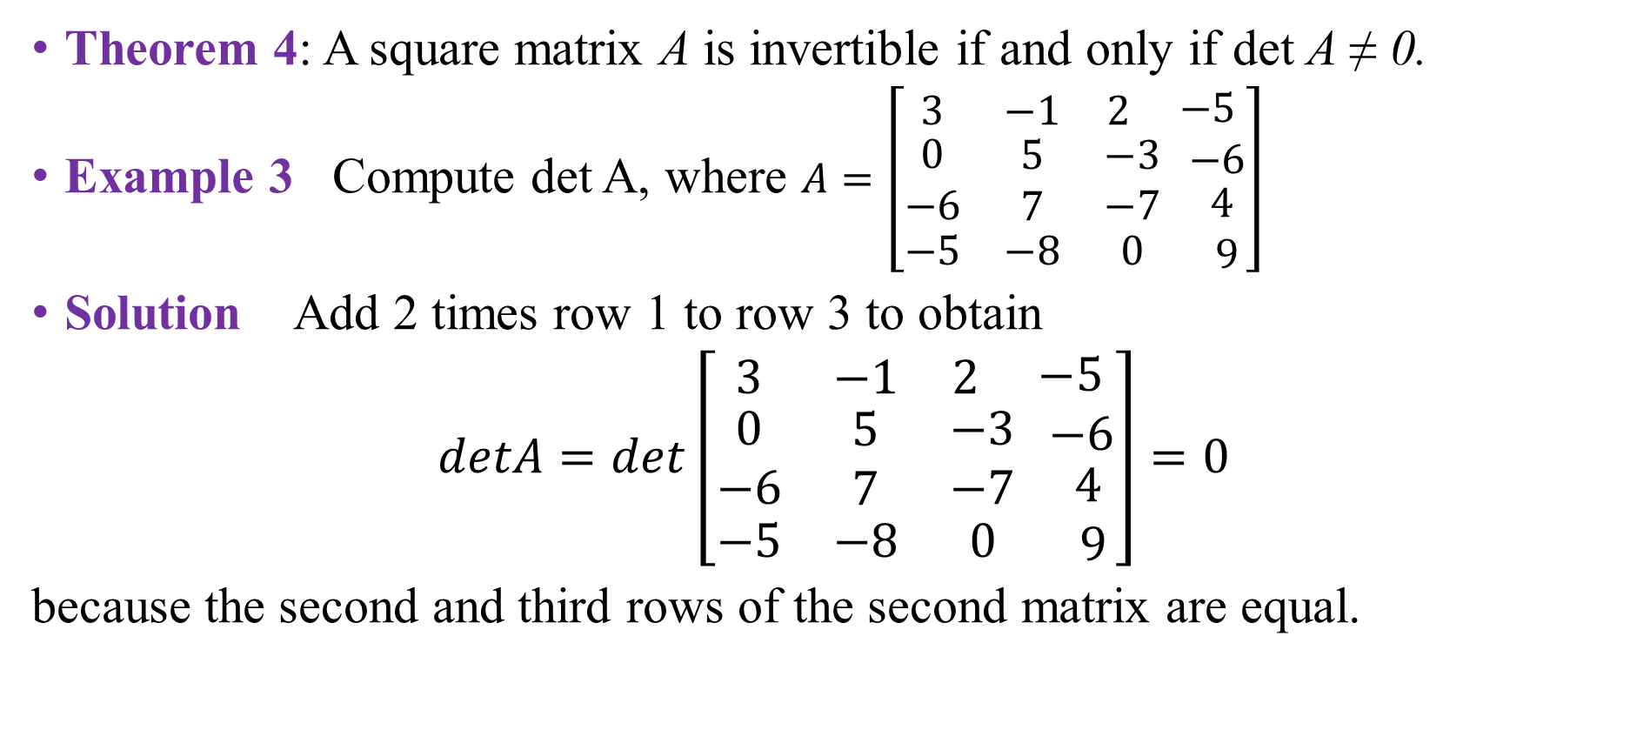
Properties of Determinants
Theorem 4: A square matrix A is invertible if and only if det A ≠ 0.
Example 3 Compute det A, where $A=\left[\begin{matrix}3 & −1 & 2 \\ \begin{aligned}0 \\ −6\end{aligned} & \begin{aligned}5 \\ 7\end{aligned} & \begin{aligned}−3 \\ −7\end{aligned} \\ −5 & −8 & 0\end{matrix} \begin{matrix}\begin{aligned}−5 \\ −6\end{aligned} \\ 4 \\ 9\end{matrix}\right]$
Solution Add 2 times row 1 to row 3 to obtain
$detA=det\left[\begin{matrix}3 & −1 & 2 \\ \begin{aligned}0 \\ −6\end{aligned} & \begin{aligned}5 \\ 7\end{aligned} & \begin{aligned}−3 \\ −7\end{aligned} \\ −5 & −8 & 0\end{matrix} \begin{matrix}\begin{aligned}−5 \\ −6\end{aligned} \\ 4 \\ 9\end{matrix}\right]=0$
because the second and third rows of the second matrix are equal.

Slide 16
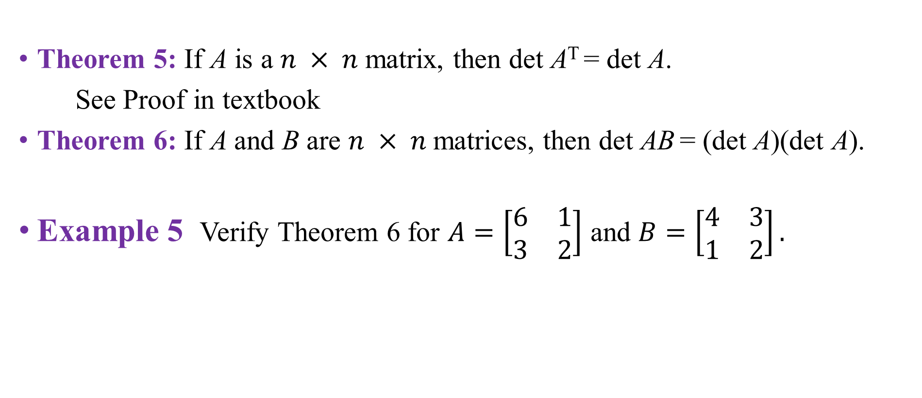
Properties of Determinants
Theorem 5: If A is a $n × n$matrix, then det A^{T} = det A.
See Proof in textbook
Theorem 6: If A and B are $n × n$matrices, then det AB = (det A)(det A).
Example 5 Verify Theorem 6 for $A=\left[\begin{matrix}6 & 1 \\ 3 & 2\end{matrix}\right]$ and $B=\left[\begin{matrix}4 & 3 \\ 1 & 2\end{matrix}\right].$

Slide 17

Properties of Determinants
Solution
$AB=\left[\begin{matrix}6 & 1 \\ 3 & 2\end{matrix}\right]\left[\begin{matrix}4 & 3 \\ 1 & 2\end{matrix}\right]$=$\left[\begin{matrix}25 & 20 \\ 14 & 13\end{matrix}\right]$
and
det$AB=25∙13−20∙14=325−280=45$
Since det A = 9 and det B = 5,
(det$A)(detB)=9∙5=45=\text{det} \text{AB}$

Slide 18
Crammer’s rule, Volume
and Linear Transformation

Slide 19
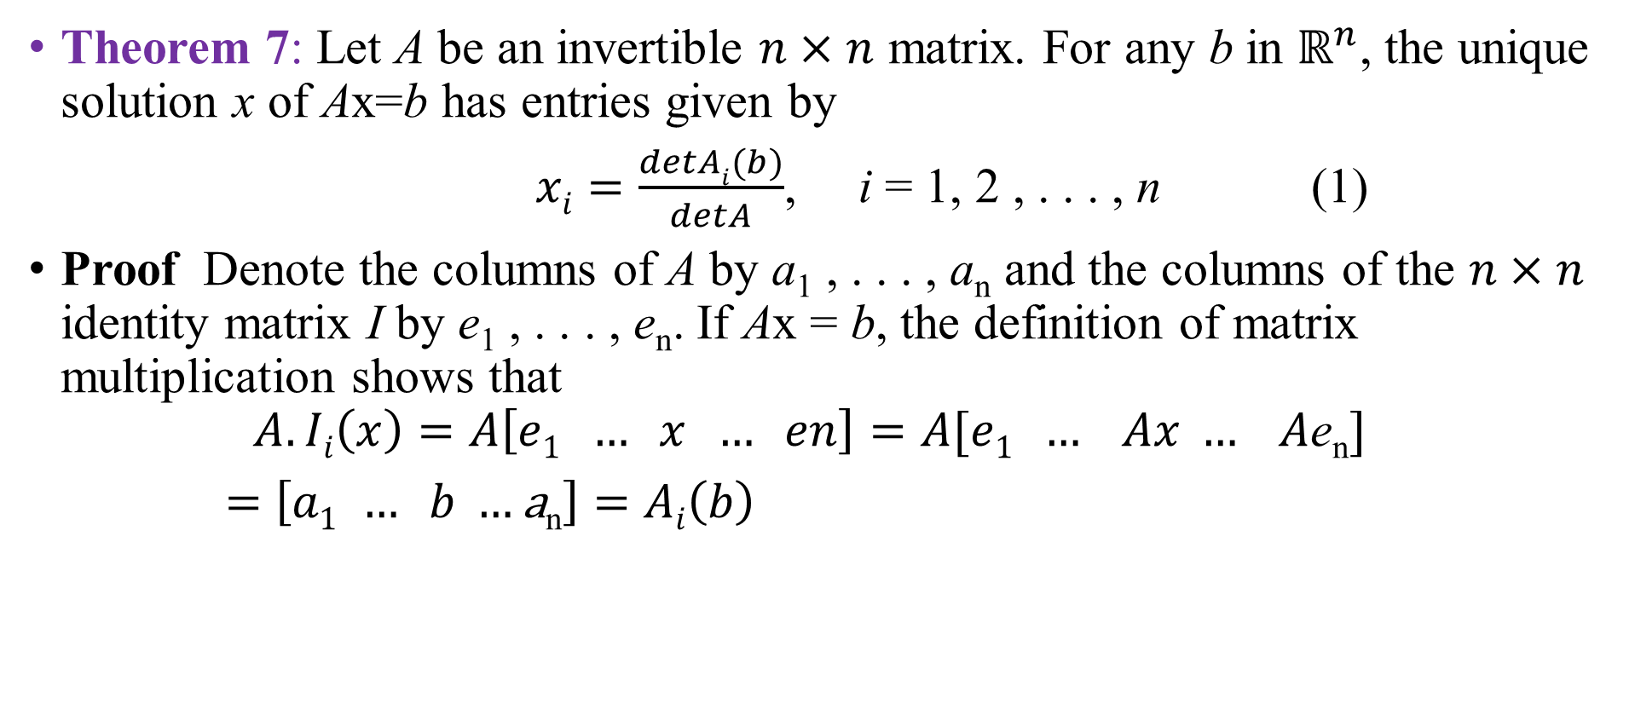
Crammer’s Rule
Theorem 7: Let A be an invertible $n×n$ matrix. For any b in $ℝ^{n}$, the unique solution x of Ax=b has entries given by
$xi=\frac{detAi(b)}{detA}$, i = 1, 2 , . . . , n (1)
Proof Denote the columns of A by a₁ , . . . , a_{n} and the columns of the $n×n$ identity matrix I by e₁ , . . . , e_{n}. If Ax = b, the definition of matrix multiplication shows that
$$A.Ii\left(x\right)=A\left[e1 … x … en\right]=A[e1 … Ax … A\text{e}\text{n}]$$
$=\left[a1 … b …\text{a}\text{n}\right]=$ $Ai\left(b\right)$

Slide 20
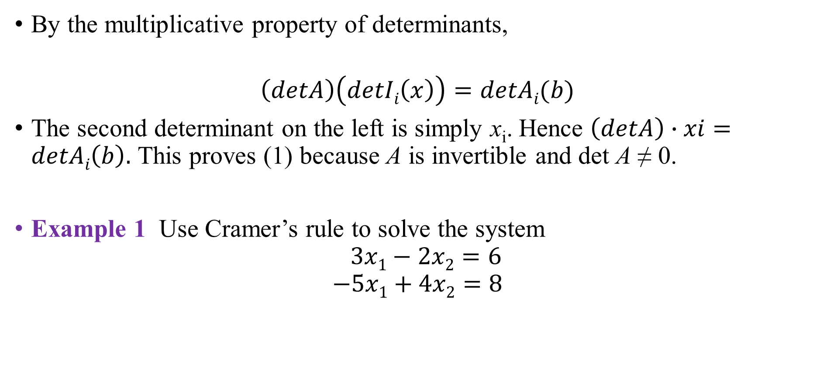
Crammer’s Rule
By the multiplicative property of determinants,
$$\left(detA\right)\left(detIi\left(x\right)\right)=detAi(b)$$
The second determinant on the left is simply x_{i}. Hence $\left(detA\right)∙xi=detAi\left(b\right).$ This proves (1) because A is invertible and det A ≠ 0.
Example 1 Use Cramer’s rule to solve the system
$$3x1−2x2=6$$
$$−5x1+4x2=8$$

Slide 21
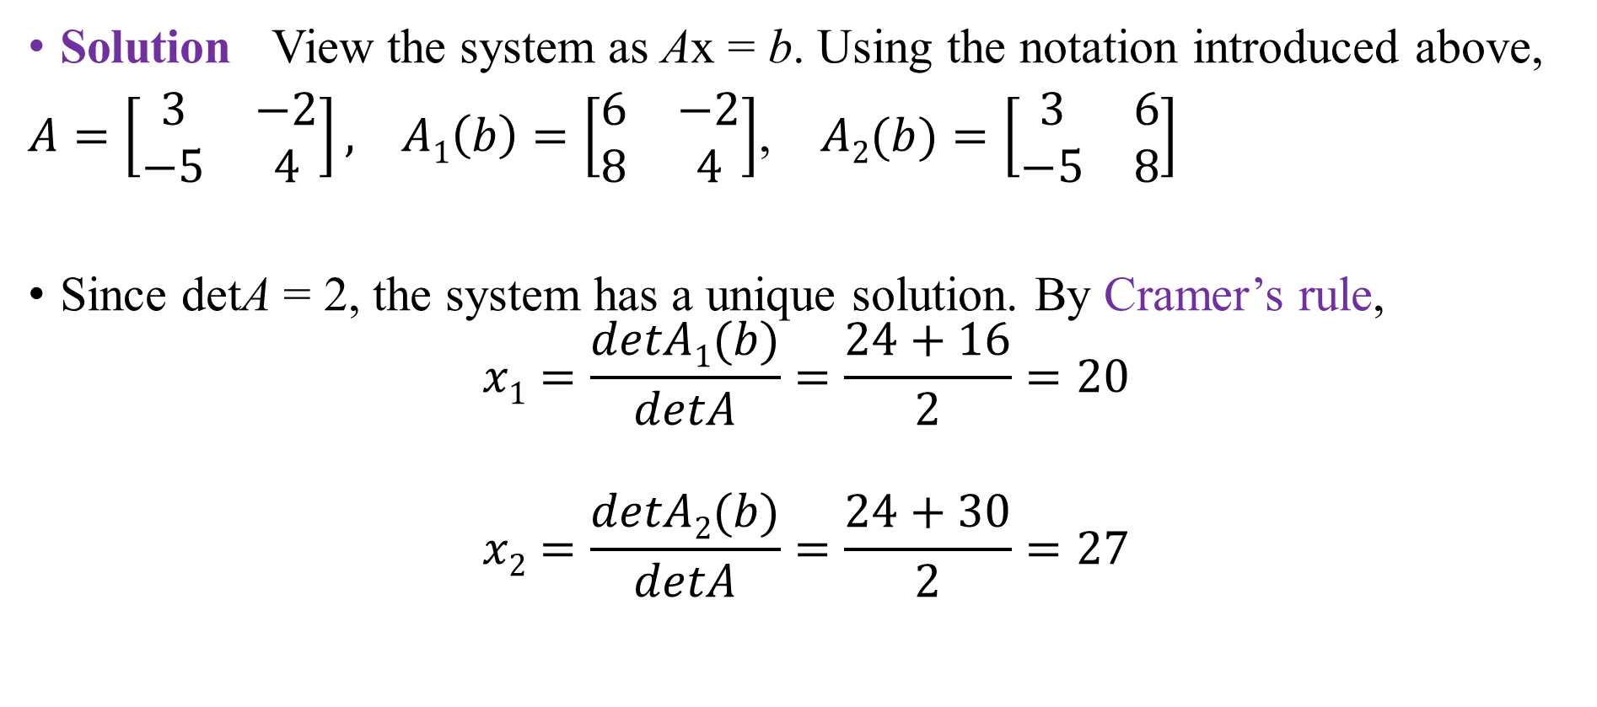
Crammer’s Rule
Solution View the system as Ax = b. Using the notation introduced above,
$A=\left[\begin{matrix}3 & −2 \\ −5 & 4\end{matrix}\right], A1\left(b\right)=\left[\begin{matrix}6 & −2 \\ 8 & 4\end{matrix}\right]$, $A2(b)=\left[\begin{matrix}3 & 6 \\ −5 & 8\end{matrix}\right]$
Since detA = 2, the system has a unique solution. By Cramer’s rule,
$$x1=\frac{detA1(b)}{detA}=\frac{24+16}{2}=20$$
$$x2=\frac{detA2(b)}{detA}=\frac{24+30}{2}=27$$

Slide 22
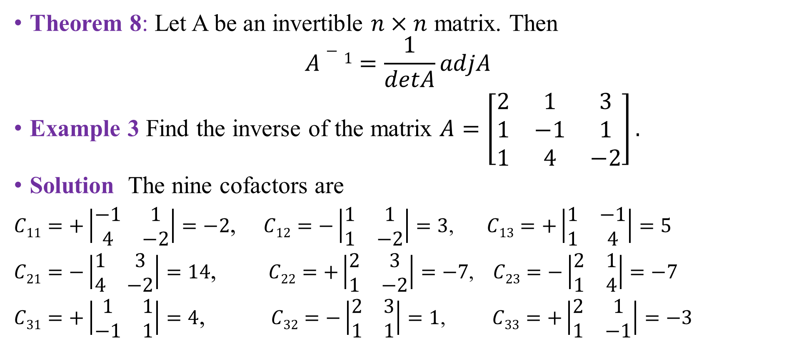
A FORMULA FOR A⁻¹
Theorem 8: Let A be an invertible $n×n$ matrix. Then
$$A−1=\frac{1}{detA}adjA$$
Example 3 Find the inverse of the matrix $A=\left[\begin{matrix}2 & 1 & 3 \\ 1 & −1 & 1 \\ 1 & 4 & −2\end{matrix}\right].$
Solution The nine cofactors are
$C11=+\left|\begin{matrix}−1 & 1 \\ 4 & −2\end{matrix}\right|=−2$, $C12=−\left|\begin{matrix}1 & 1 \\ 1 & −2\end{matrix}\right|=3$, $C13=+\left|\begin{matrix}1 & −1 \\ 1 & 4\end{matrix}\right|=5$
$C21=−\left|\begin{matrix}1 & 3 \\ 4 & −2\end{matrix}\right|=14$, $C22=+\left|\begin{matrix}2 & 3 \\ 1 & −2\end{matrix}\right|=−7$, $C23=−\left|\begin{matrix}2 & 1 \\ 1 & 4\end{matrix}\right|=−7$
$C31=+\left|\begin{matrix}1 & 1 \\ −1 & 1\end{matrix}\right|=4$, $C32=−\left|\begin{matrix}2 & 3 \\ 1 & 1\end{matrix}\right|=1$, $C33=+\left|\begin{matrix}2 & 1 \\ 1 & −1\end{matrix}\right|=−3$

Slide 23
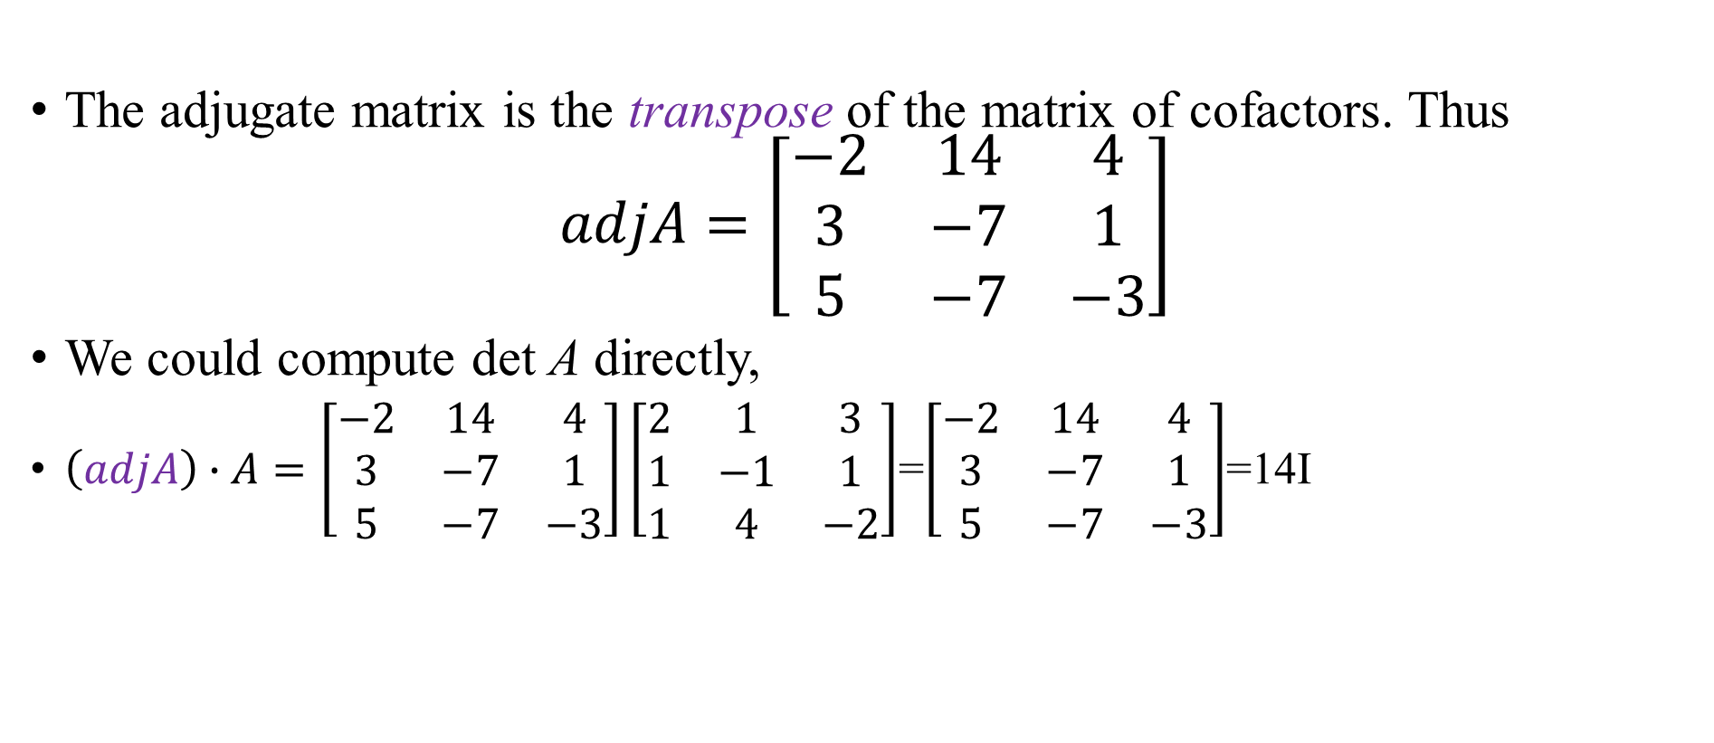
A FORMULA FOR A⁻¹
The adjugate matrix is the transpose of the matrix of cofactors. Thus
$$adjA=\left[\begin{matrix}−2 & 14 & 4 \\ 3 & −7 & 1 \\ 5 & −7 & −3\end{matrix}\right]$$
We could compute det A directly,
$\left(adjA\right)∙A=\left[\begin{matrix}−2 & 14 & 4 \\ 3 & −7 & 1 \\ 5 & −7 & −3\end{matrix}\right]\left[\begin{matrix}2 & 1 & 3 \\ 1 & −1 & 1 \\ 1 & 4 & −2\end{matrix}\right]$=$\left[\begin{matrix}−2 & 14 & 4 \\ 3 & −7 & 1 \\ 5 & −7 & −3\end{matrix}\right]$=14I

Slide 24

A FORMULA FOR A⁻¹
Since (adj A)A = 14I, Theorem 8 shows that det A = 14 and
$$A−1=\frac{1}{14}\left[\begin{matrix}−2 & 14 & 4 \\ 3 & −7 & 1 \\ 5 & −7 & −3\end{matrix}\right]=\left[\begin{matrix}−1/7 & 1 & 2/7 \\ 3/14 & −1/2 & 1/14 \\ 5/14 & −1/2 & −3/14\end{matrix}\right]$$

Slide 25
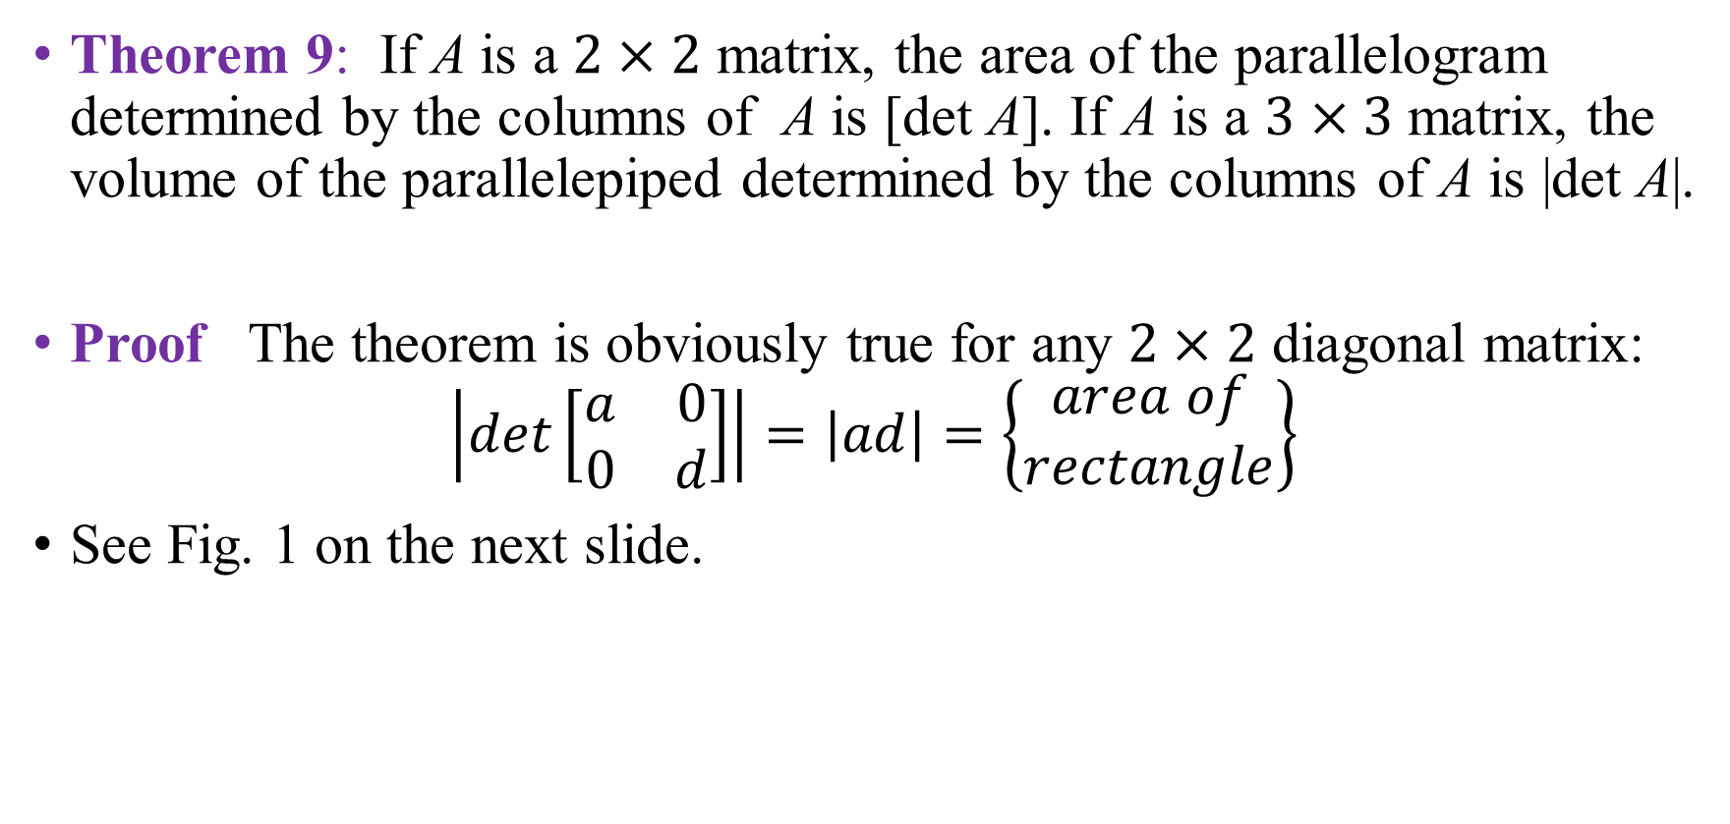
DETERMINANTS AS AREA OR VOLUME
Theorem 9: If A is a $2×2$ matrix, the area of the parallelogram determined by the columns of A is [det A]. If A is a $3×3$ matrix, the volume of the parallelepiped determined by the columns of A is |det A|.
Proof The theorem is obviously true for any $2×2$ diagonal matrix:
$$\left|det\left[\begin{matrix}a & 0 \\ 0 & d\end{matrix}\right]\right|=\left|ad\right|=\left\{\begin{aligned}area of \\ rectangle\end{aligned}\right\}$$
See Fig. 1 on the next slide.

Slide 26

DETERMINANTS AS AREA OR VOLUME
It will suffice to show that any 2 $×$ 2 matrix A = [a₁ a₂] can be transformed into a diagonal matrix in a way that changes neither the area of the associated parallelogram nor |det A|.

Slide 27
DETERMINANTS AS AREA OR VOLUME
Let a₁ and a₂ be nonzero vectors. Then for any scalar c, the area of the parallelogram determined by a₁ and a₂ equals the area of the parallelogram determined by a₁ and a₂+ca₁.
To prove this statement, we may assume that a₂ is not a multiple of a₁, for otherwise the two parallelograms would be degenerate and have zero area.
If L is the line through 0 and a₁, then a₂ + L is the line through a₂ parallel to L, and a₂ + ca₁ is on this line. See Fig. 2 on the next slide.

Slide 28
DETERMINANTS AS AREA OR VOLUME
The points a₂ and a₂ + ca₁ have the same perpendicular distance to L. Hence the two parallelograms in Fig. 2 have the same area, since they share the base from 0 to a₁.

Slide 29

DETERMINANTS AS AREA OR VOLUME
The proof for $ℝ^{3}$ is similar. The theorem is obviously true for a 3$×$ 3 diagonal matrix. See Fig. 3 below:

Slide 30

DETERMINANTS AS AREA OR VOLUME
And any 3$×$3 matrix A can be transformed into a diagonal matrix using column operations that do not change |det A|.
A parallelepiped is shown in Fig. 4 below as a shaded box with two sloping sides.

Slide 31
DETERMINANTS AS AREA OR VOLUME
Its volume is the area of the base in the plane Span{a₁, a₃} times the altitude of a₂ above Span{a₁, a₃}. Any vector a₂ + ca₁ lies in the plan Span{a₁, a₃}, which is parallel to Span{a₁, a₃} .
Hence the volume of the parallelepiped is unchanged when [a₁ a₂ a₃] is changed to [a₁ a₂ +ca₁ a₃].

Slide 32
DETERMINANTS AS AREA OR VOLUME
Example 4 Calculate the area of the parallelogram determined by the points (-2, -2), (0, 3), (4, -1), and (6, 4). See Fig. 5(a) below:

Slide 33
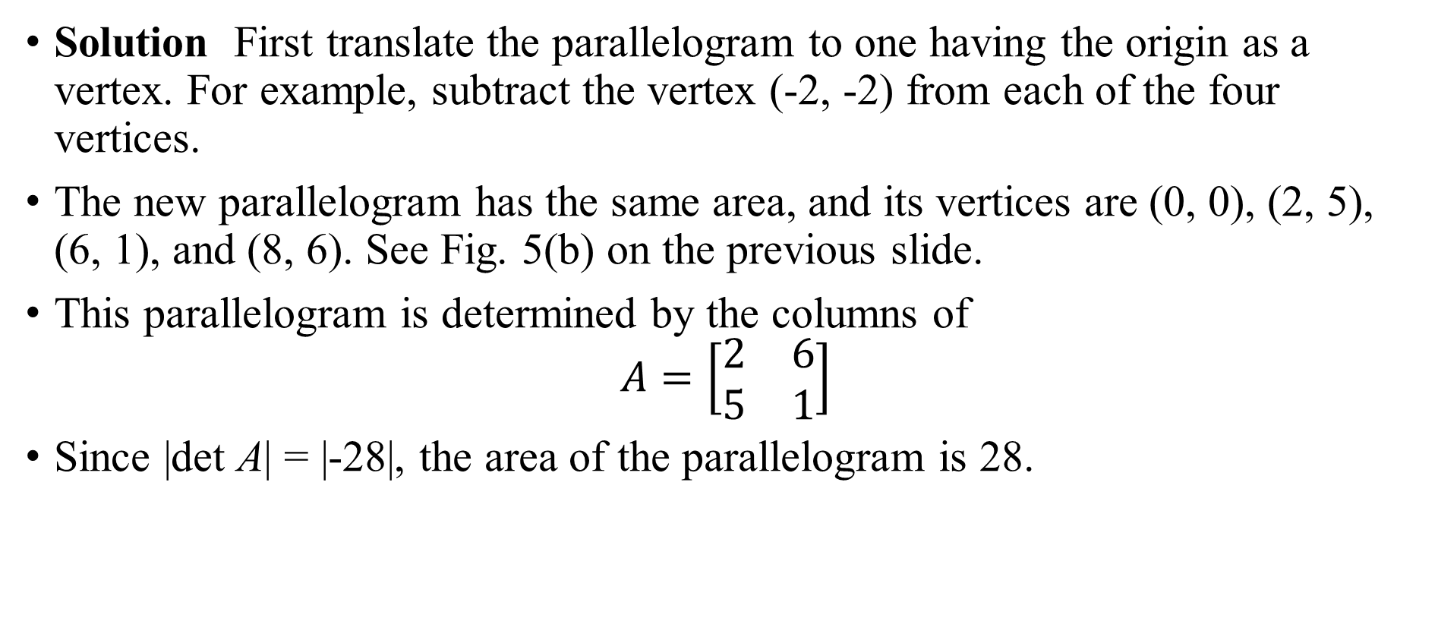
DETERMINANTS AS AREA OR VOLUME
Solution First translate the parallelogram to one having the origin as a vertex. For example, subtract the vertex (-2, -2) from each of the four vertices.
The new parallelogram has the same area, and its vertices are (0, 0), (2, 5), (6, 1), and (8, 6). See Fig. 5(b) on the previous slide.
This parallelogram is determined by the columns of
$$A=\left[\begin{matrix}2 & 6 \\ 5 & 1\end{matrix}\right]$$
Since |det A| = |-28|, the area of the parallelogram is 28.

Slide 34
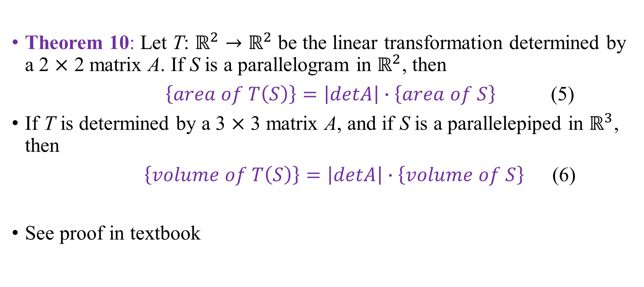
LINEAR TRANSFORMATIONS
Theorem 10: Let T: $ℝ^{2}→ℝ^{2}$ be the linear transformation determined by a 2 $×$ 2 matrix A. If S is a parallelogram in $ℝ^{2}$, then
$\left\{area of T\left(S\right)\right\}=\left|detA\right|∙\left\{area of S\right\}$ (5)
If T is determined by a 3 $×$ 3 matrix A, and if S is a parallelepiped in $ℝ^{3}$, then
$\left\{volume of T\left(S\right)\right\}=\left|detA\right|∙\left\{volume of S\right\}$ (6)
See proof in textbook

Slide 35
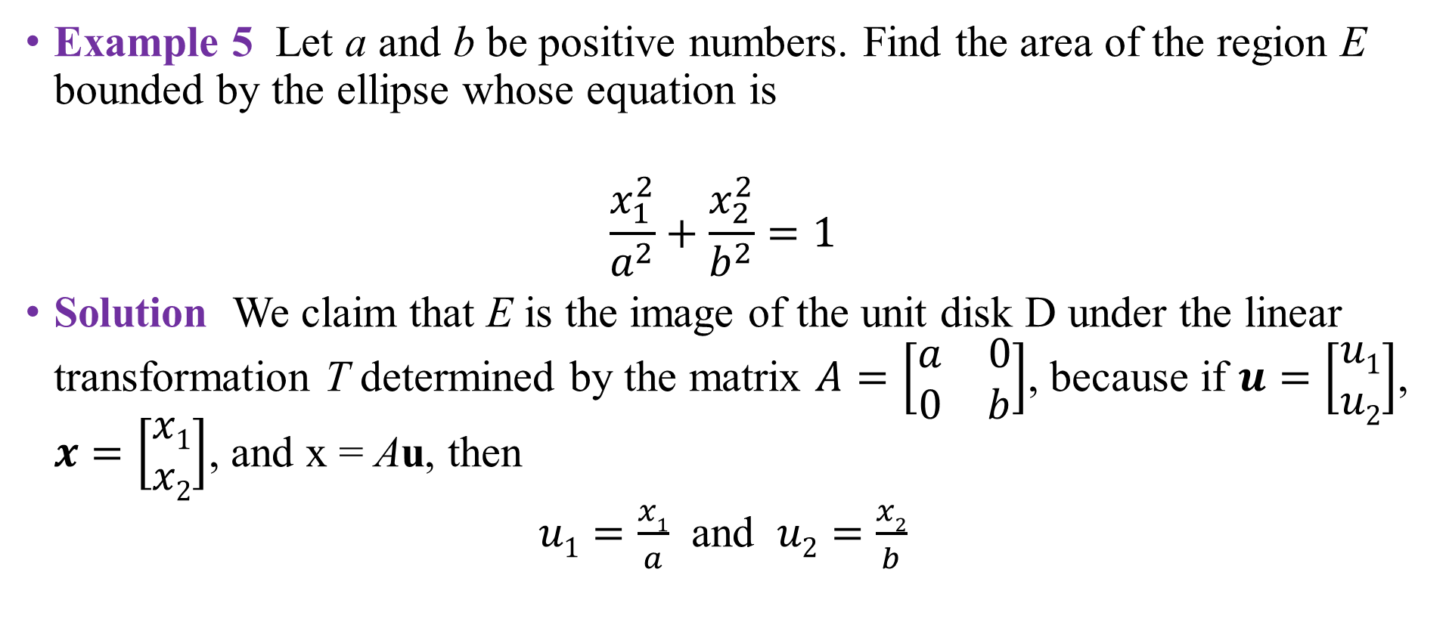
LINEAR TRANSFORMATIONS
Example 5 Let a and b be positive numbers. Find the area of the region E bounded by the ellipse whose equation is
$$\frac{x_{1}^{2}}{a^{2}}+\frac{x_{2}^{2}}{b^{2}}=1$$
Solution We claim that E is the image of the unit disk D under the linear transformation T determined by the matrix $A=\left[\begin{matrix}a & 0 \\ 0 & b\end{matrix}\right]$, because if $u=\left[\begin{aligned}u1 \\ u2\end{aligned}\right]$, $x=\left[\begin{aligned}x1 \\ x2\end{aligned}\right]$, and x = Au, then
$u1=\frac{x1}{a}$ and $u2=\frac{x2}{b}$

Slide 36
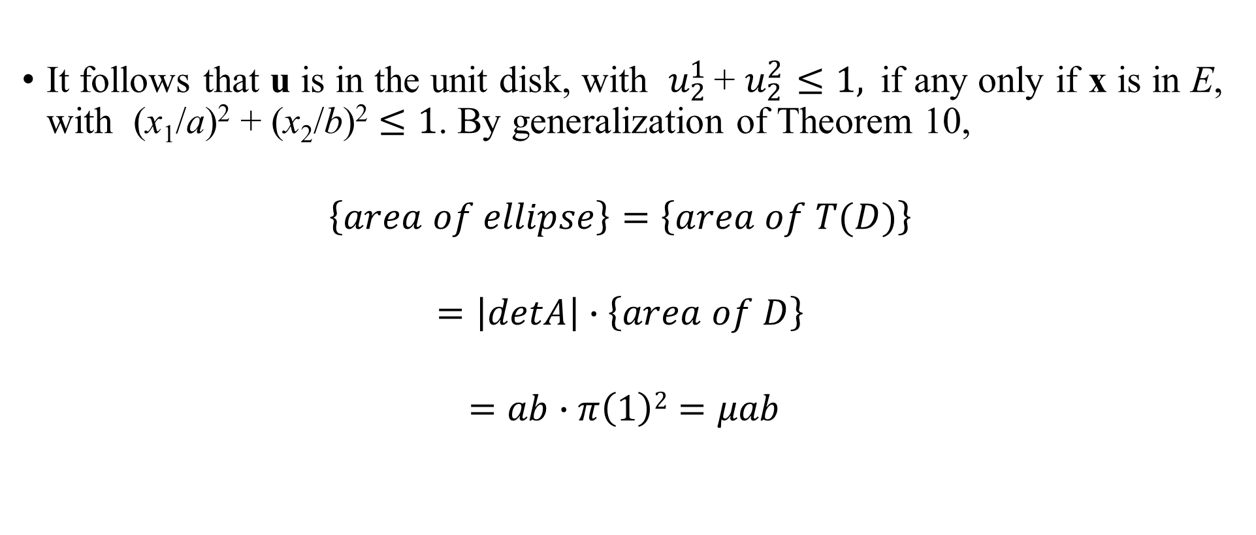
LINEAR TRANSFORMATIONS
It follows that u is in the unit disk, with $u_{2}^{1 }$+ $u_{2}^{2}≤1,$if any only if x is in E, with (x₁/a)² + (x₂/b)² $≤1$. By generalization of Theorem 10,
$$\left\{area of ellipse\right\}=\left\{area of T(D)\right\}$$
$$=\left|detA\right|∙\left\{area of D\right\}$$
$$=ab∙π\left(1\right)2=μab$$

Slide 37
Thank you for listening

